Slide 1

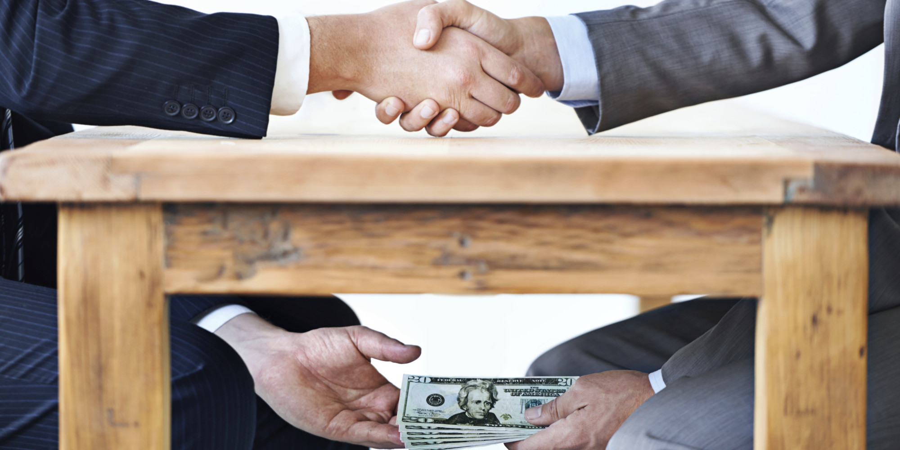
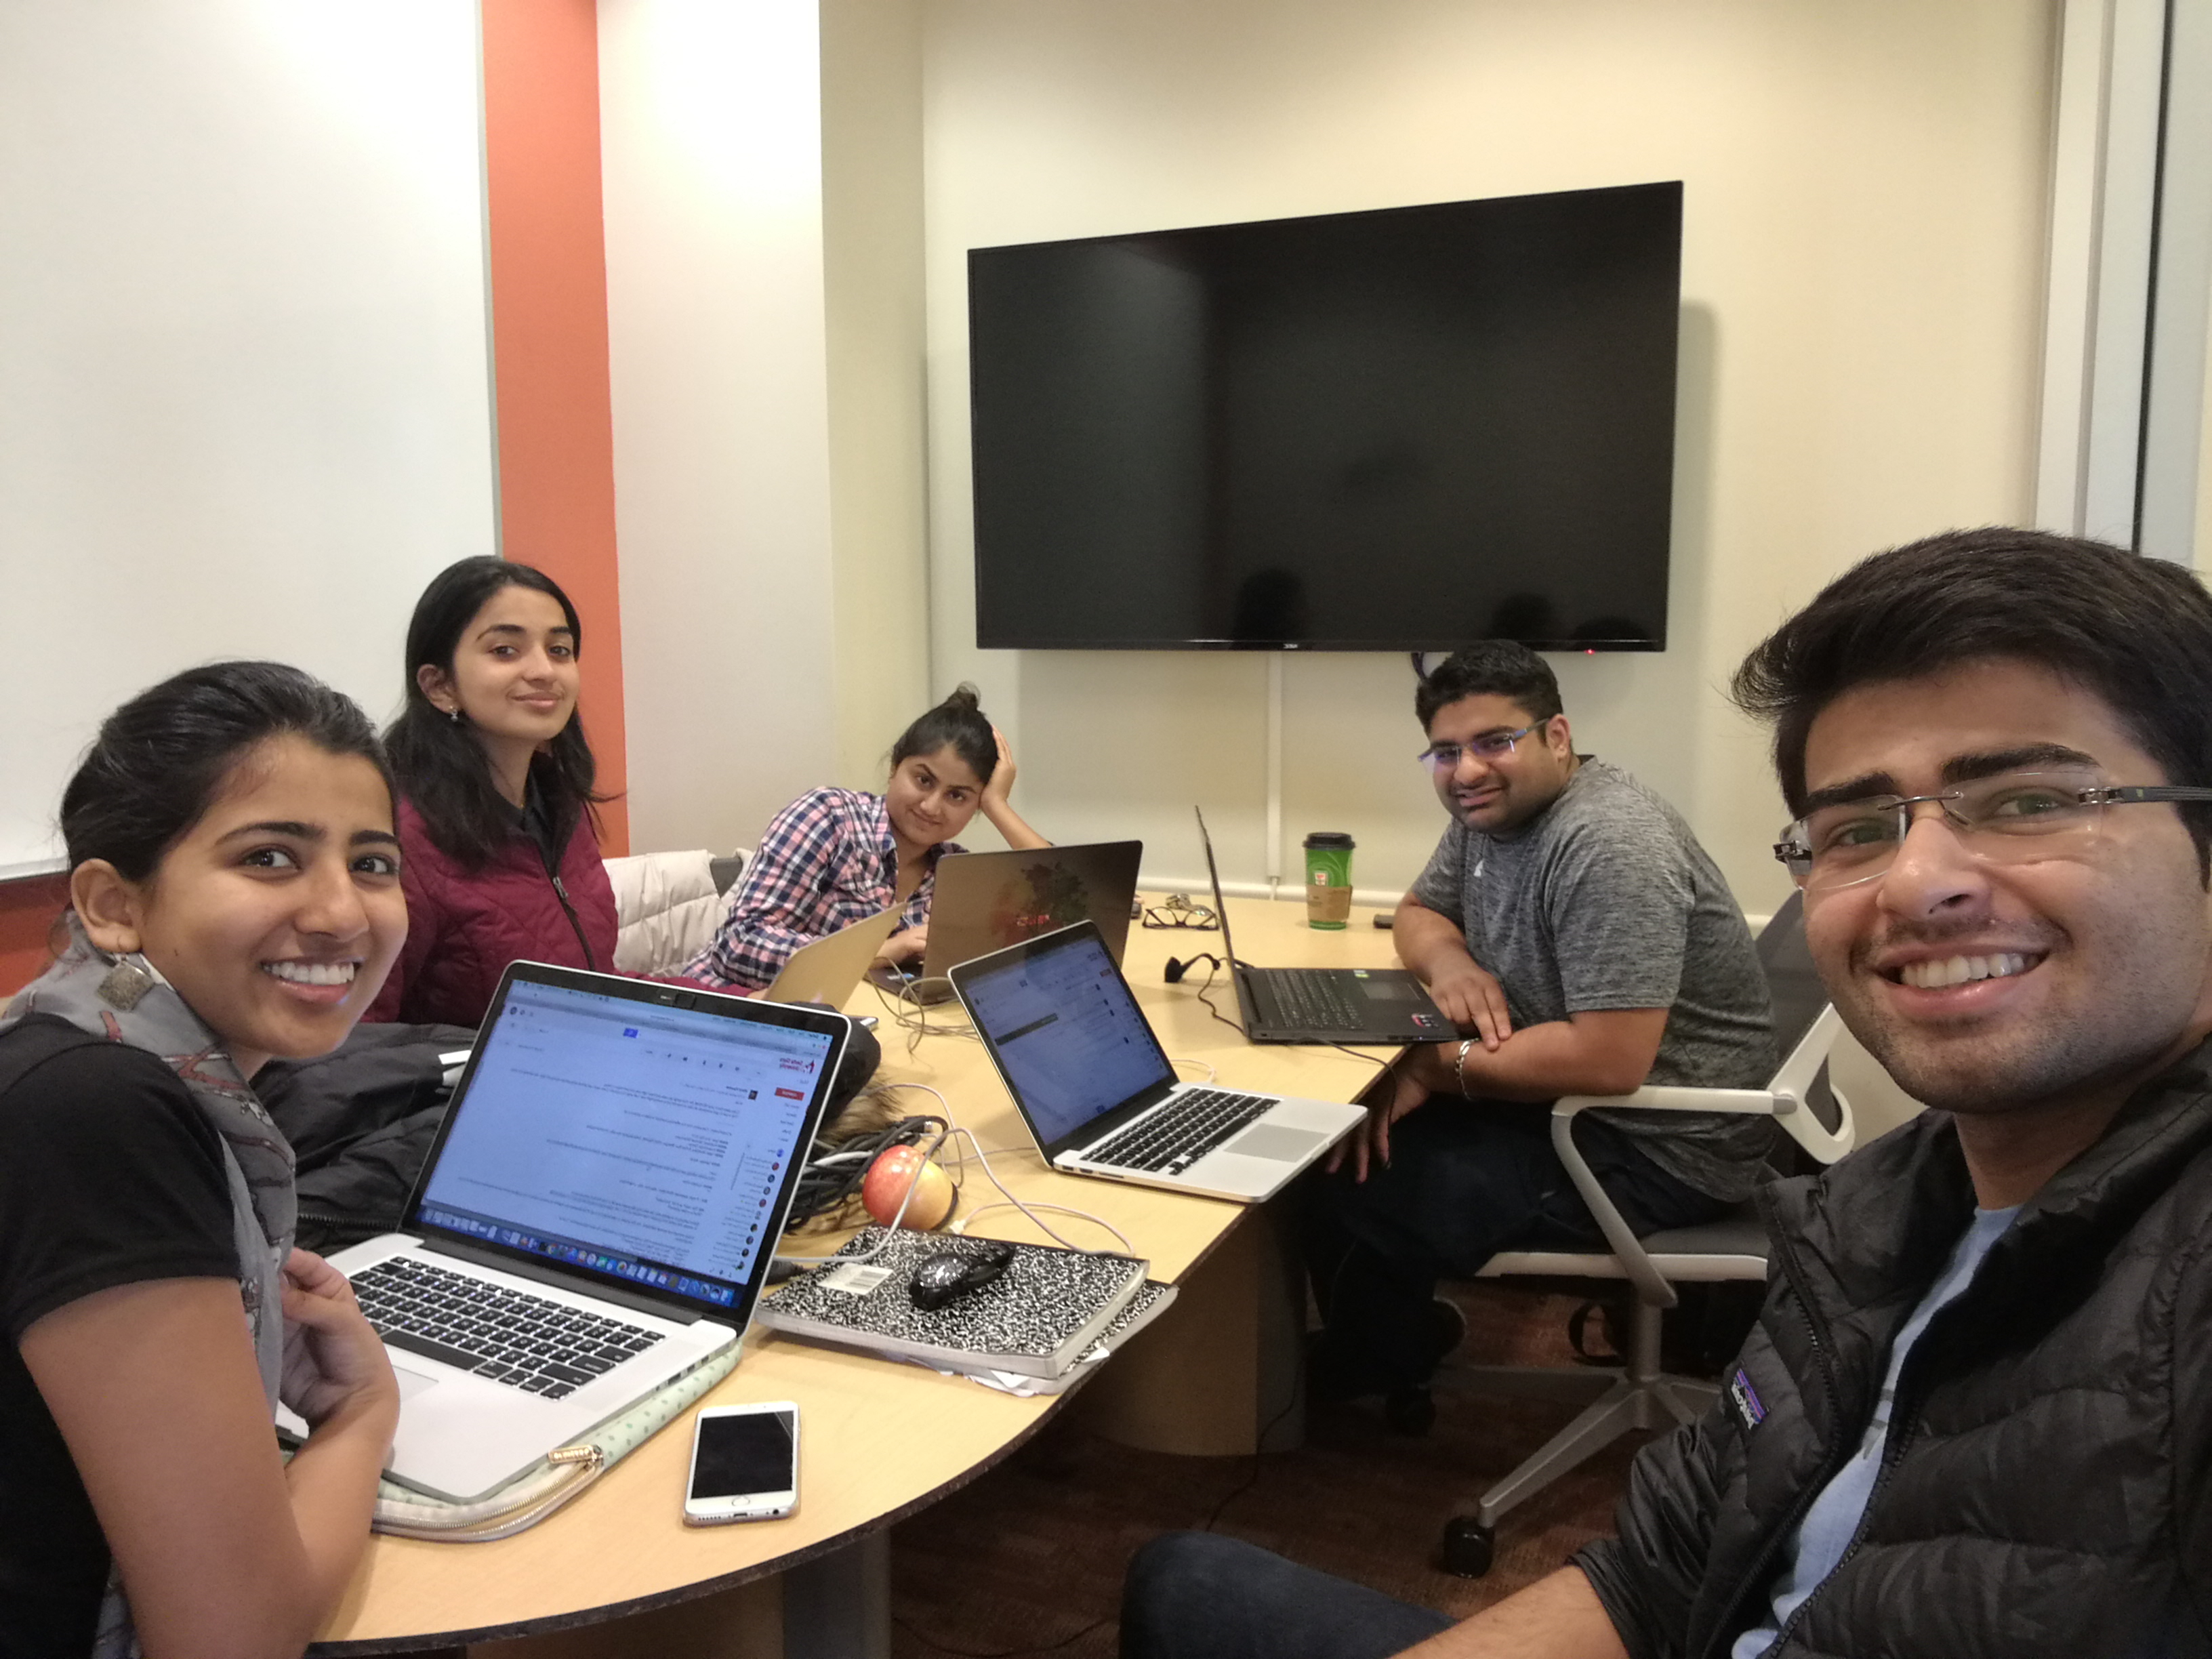
Corruption
Team members
Embar ravi bhargav | Neha Goushal | Nikhil Kaushik Parvathy Ramar Kovilakom | Priyanka Nirpase

Slide 2
Higher Corruption Perspective Index = Lower Corruption

Slide 3
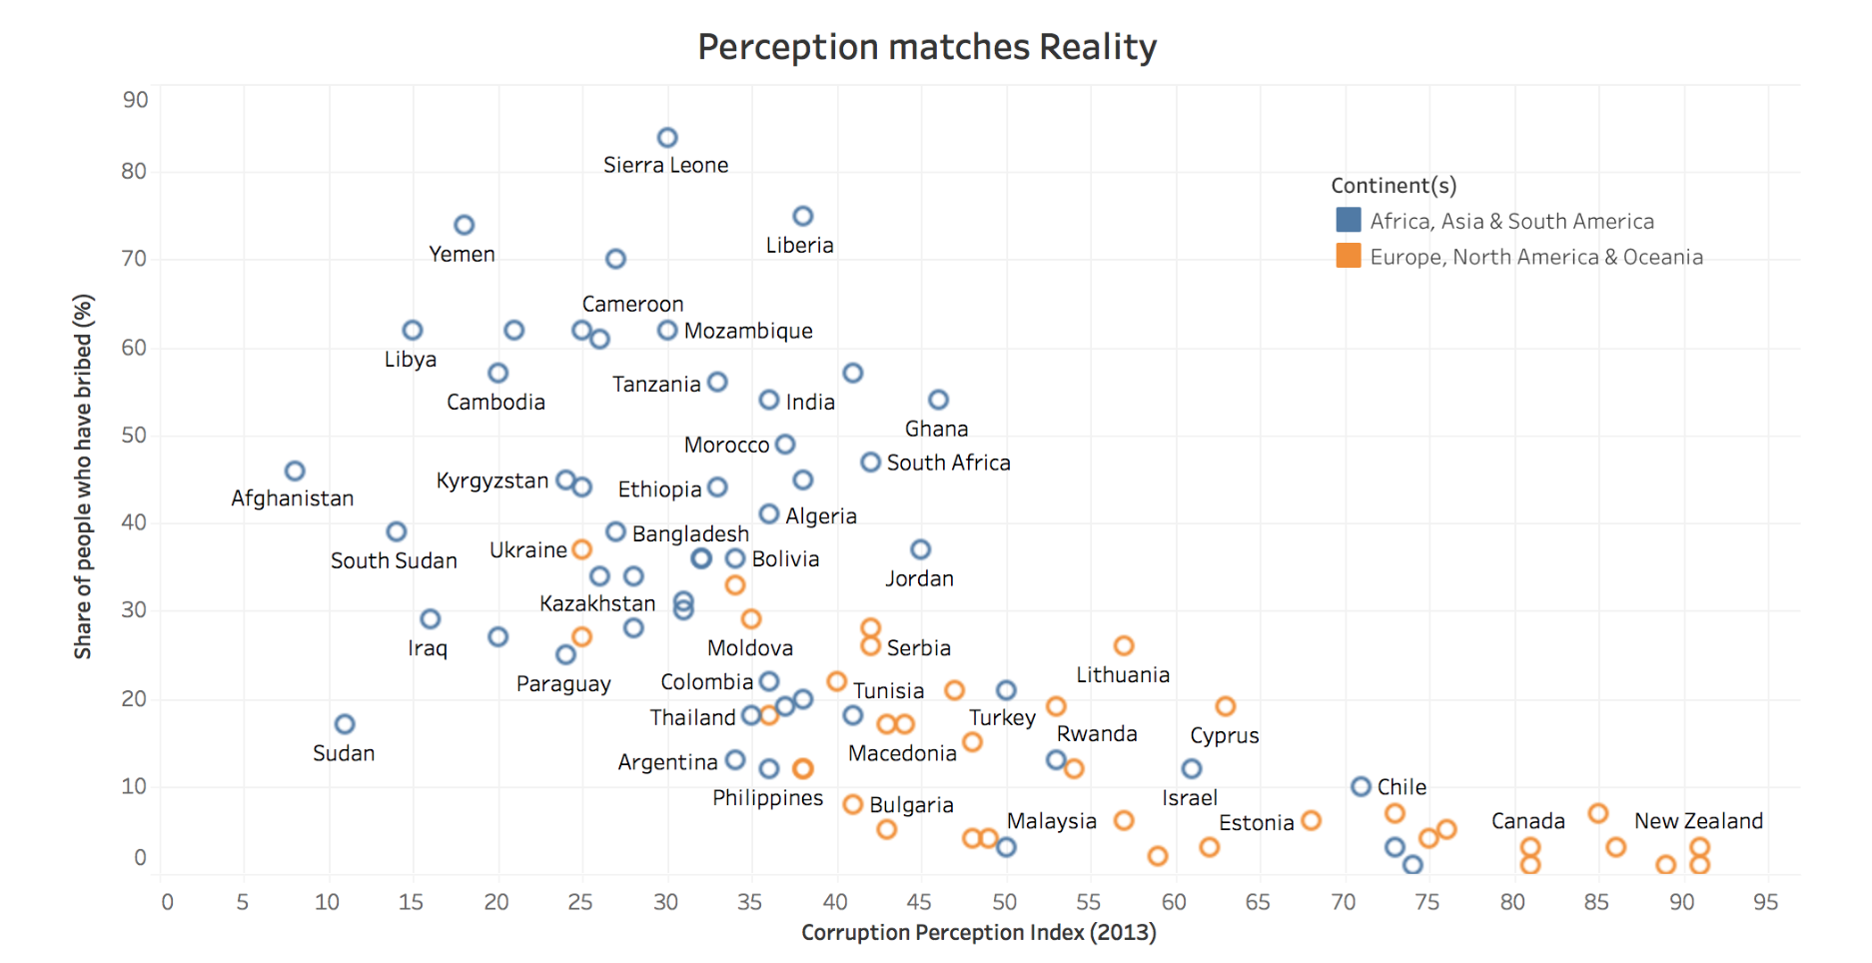
Visualization 1

Slide 4
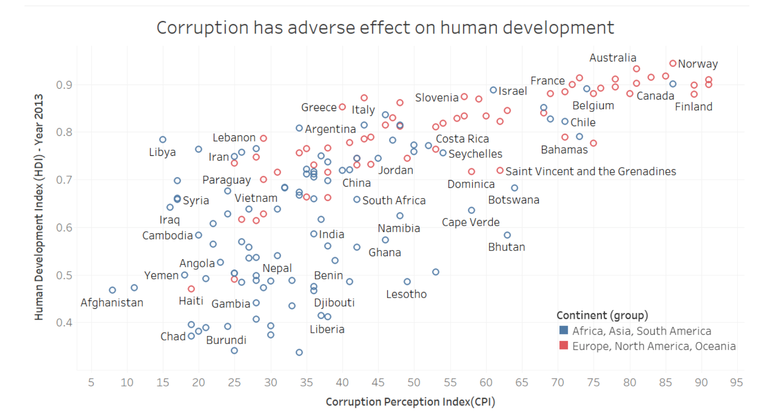
Visualization 2

Slide 5
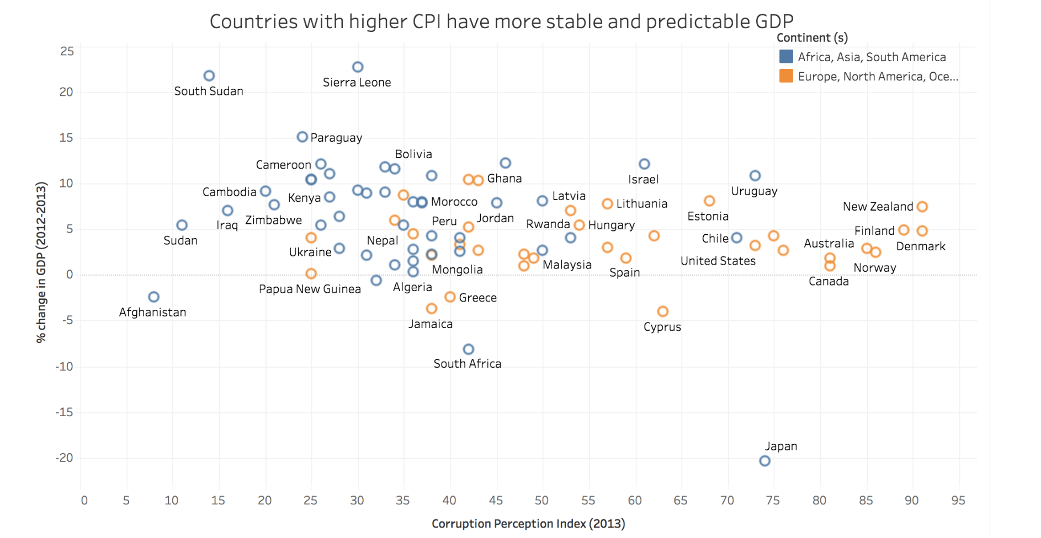
Visualization 3

Slide 6
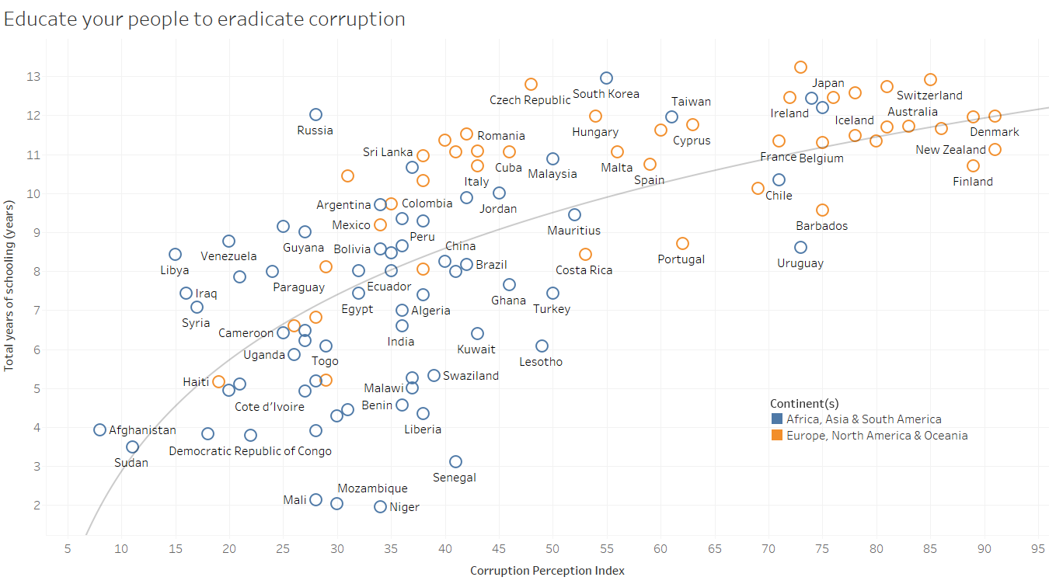
Visualization 4

Slide 7
CONCLUSION
CPI
HDI
GDP
EDUCATION
THANK YOU !

